Slide 1
PCB Routing
Tianxiao

Slide 2
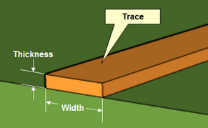
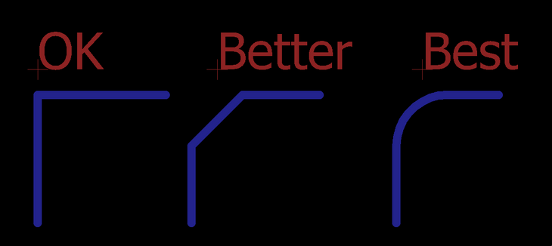

Routing
Don’t rely on Autorouter
An aid to find bottleneck (at the position it fails to continue)
Ask for specification
Minimum trace width (next page)
Minimum trace spacing (at least 0.01mm)
Route with grid
Snap grid 0.5mm for routing (depends on trace width)
Avoid 90 degree trace angles
Leave room between traces and mounting holes
Power lines
Create a ground plane
Make power and ground traces wider
Silkscreen
Wire, text, circle…
Layer: 25 tNames, 26 bNames

Slide 3
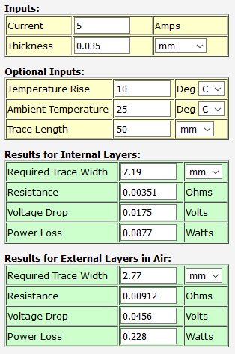
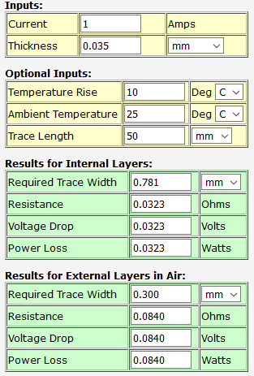
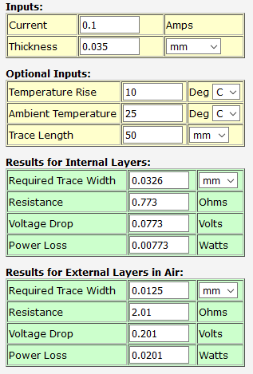
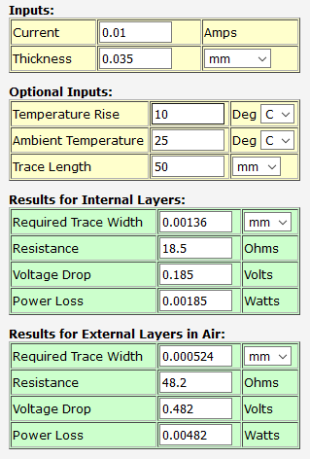
Routing
Trace width
PCB trace width calculator link
Thickness 0.035mm
As wide as possible
5A 2.77mm
1A 0.3mm
0.1A 0.0125mm
0.01A 0.0005mm

